Slide 1
Modernizing the Physics Curriculum
Rudi Michalak, University of Wyoming
APS April Meeting, Denver, April 13-15 2019

Slide 2
Weak or outdated points of our curriculum
Applied coding (1)
Relevant coding languages (2)
Professional writing (3)
Professional conversations (4)
Transition from High School support (5)
Transition to upper level classes support (6)
Assessment (7)
Two prong approach: Strengthen freshman support
Build job skills (based on local alumni and APS data)
New courses which address these areas:
First Year Seminar: (3), (4), (5), (7)
Physics Methods: (1), (2), (6), (7)
Advanced Lab: (3), (4), (7) develops FYS skills further

Slide 3
Dealing with university course regulations: [excerpts]
demonstrate active listening skills
engage opposing viewpoints constructively
Find, analyse, evaluate, and document information
Make effective use of multiple drafts, revision, peer and instructor comments
conventions of spelling, grammar, organizational structure, punctuation, delivery and documentation
discourse of a discipline
Deliver presentations in a confident and professional manner
completing a substantial communication project that requires appropriate research skills
communication standards in a discipline
Recognize and evaluate aspects of communication that respond to the purposes and needs of audiences
Interact effectively with audience members

Slide 4
Transition Difficulty
Tool Box
● First Year Seminar
The idea: get them early, provide early identification as major,
motivate, reduce attrition
Trade-offs: can’t restrict to majors only
no Math prereqs
competes with high stakes courses (Calc, Gen Phys.)
● Spread General Physics 1-2 into Gen Phys 1-3
The idea: Provide the time needed to grow
Trade-off delays college level physics
Solution Offer Methods class in same term as Phys 3

Slide 5
The Advanced Modern Physics Lab @ UW
Meeting Professional Difficulty
Tool Box
Before
A typical upper level physics lab course:
electronics
data fitting
landmark experiments
unguided report writing
After
Standard Grading w/ Bloom’s Taxonomy
Writing in the Profession
New Dimensions: Oral Prelabs and Exams
increasingly conversations as colleague
Fosters : identification as physicist/ astronomer
Allows new channels of assessment

Slide 6
A twist on standard grading
Turn all activities into gradable events
• three levels loosely following Bloom’s Taxonomy
(1- memorization 2- application 3- analysis & synthesis)
• students earn one level at a time
can repeat as many times as needed = flexible grade
students are encouraged to tackle their weak spots
students can be proactive
• earn standards in
lecture
seminar
prelab
lab work
reports
inlabs
oral exams

Slide 7
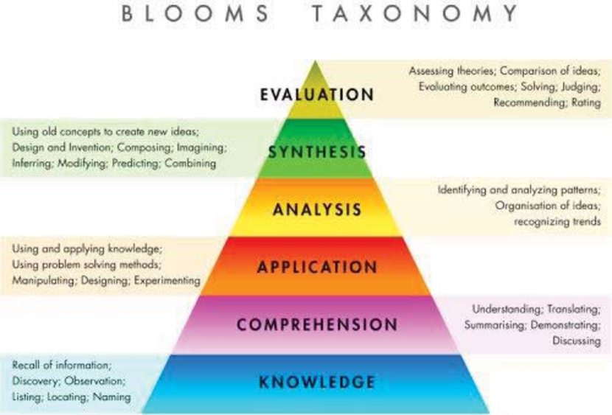
Modified Bloom’s Taxonomy
Streamlined to:
Basic = memorization
Advanced = understanding, application
Proficient = Analysis, synthesis
Bloom, B. S.; Engelhart, M. D.; Furst, E. J.; Hill, W. H.; Krathwohl, D. R. (1956). Taxonomy of educational objectives: The classification of educational goals. Handbook I: Cognitive domain. New York: David McKay Company.

Slide 8
Focus on professional discussions:
The exams are essentially professional discussions among colleagues. Unlike with prelabs this expects a different level of competence in your answers. Emphasis is also put toward professional conduct, which includes behaviour, preparedness, and a number of COM3 categories. One can compare the experience somewhat to presenting a poster at a scientific conference
Prelabs are professional conversations between instructor and student about topics that relate to a particular experiment. The student can start freely and should choose a topic that she is strong at and/or a topic that will satisfy a needed standard.
Inlabs are discussions in a hands-on situation: How did you decide how many data points you need, how many repetitions, which errors dominate, how did you make sure you do not skew your data distributions? This mimics the interactions between a graduate adviser and her graduate student.

Slide 9
Entry level junior year capstone class
‘Physics Methods’
● Problem: traditional math courses
They teach something different than what we hope for:
Are often too abstract/ not applied enough
Are offered too late (prereq delay)
● Problem: programming classes
They teach something different than what we hope for
Week 4: ‘how to use the print command’- problem
Who knows what language clone they’ll use
● Solution: Preview math needed for Theoretical Physics
Only topics of immediate practical impact
Delivered before needed, not after
● Solution: Introduce exactly the programming skill we need
Start with canned algorithm and modify for a practical need
Using the coding language we prefer
Integrate it in hw of our other classes

Slide 10
Possible Additions:
● Mechanical workshop experience
● Presentation skill training

Slide 11
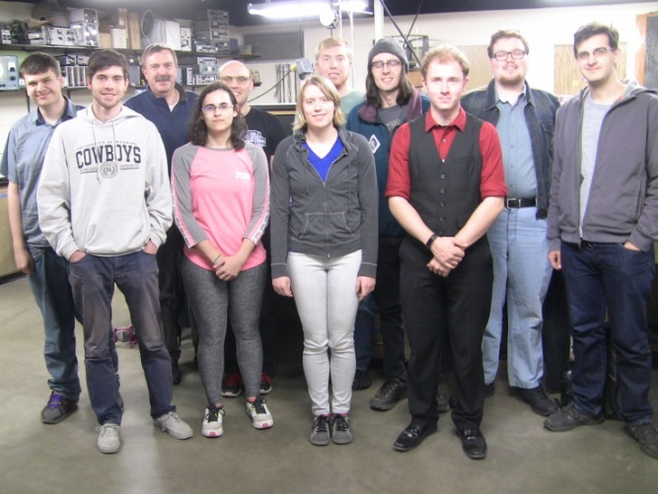
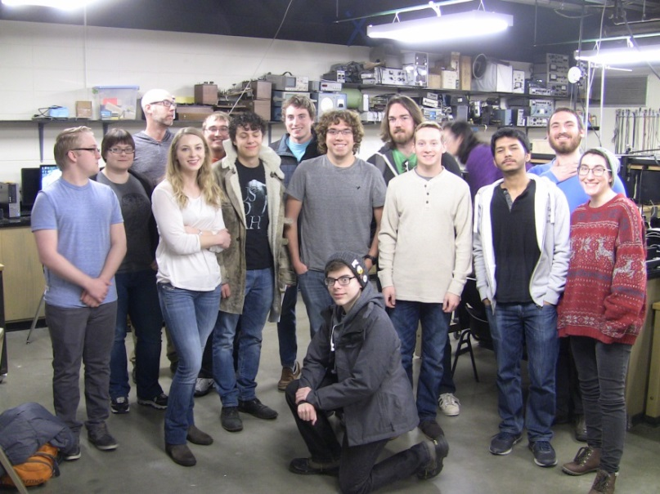
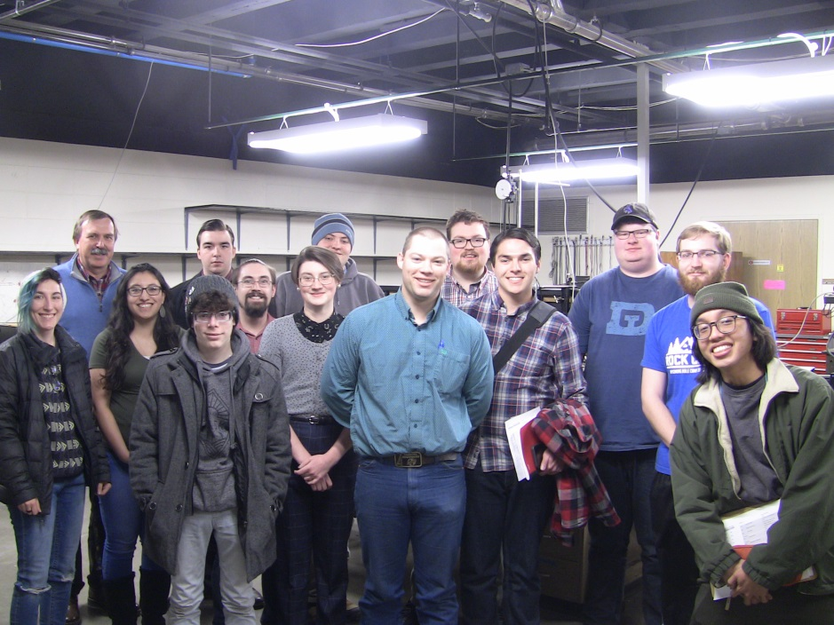
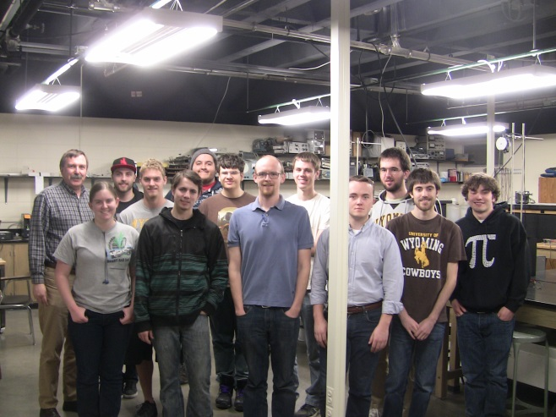
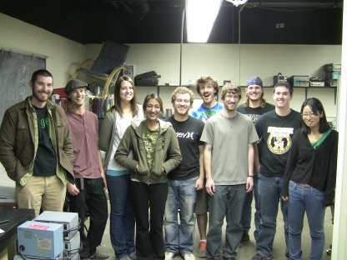
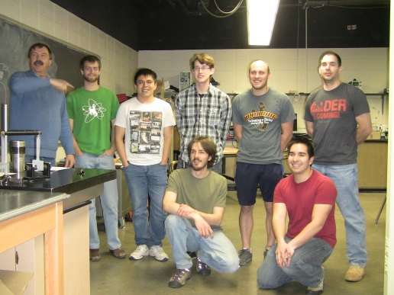
http://physics.uwyo.edu/~rudim/index_3650.html
2017
2018
Spring 2019
2016
2015
2014

